Slide 1
Chapter 1
1.1 Introduction to digital signals and systems, Properties and
operations on digital signals, Introduction to biosignals:
ECG, EEG, EMG, PPG
1.2 Classification of signals, system, LTI system
1.3 Convolution in time domain (linear & circular),
Correlation.

Slide 2
Signal
A signal is a pattern of variation that carry information.
Signals are represented mathematically as a function of one or more independent variable.
A picture is brightness as a function of two spatial variables, x and y.
In this course signals involving a single independent variable, generally refer to as a time, t are considered. Although it may not represent time in specific application.
A signal is a real-valued or scalar-valued function of an independent variable t.

Slide 3
Example of signals
Electrical signals like voltages, current and EM field in circuit
Acoustic signals like audio or speech signals (analog or digital)
Video signals like intensity variation in an image
Biological signal like sequence of bases in gene
Noise which will be treated as unwanted signal

Slide 4
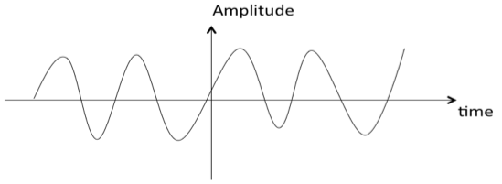
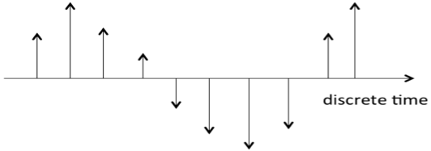
Classification of Signal
Continuous Time and Discrete Time Signals
A signal is said to be continuous when it is defined for all instants of time.
A signal is said to be discrete when it is defined at only discrete instants of time

Slide 5
Signal Processing
Representation, transformation and manipulation of signals and the information they contain.
Signal operation include:
(1) Transform, filter, inspection, spectrum analysis;
(2) Modulation and coding;
(3) Analog Signal Processing;
(4) Digital Signal Processing.

Slide 6
Processing of analog signal with digital methods
(1) Digitalized process for analog signals
x_{a}(t)
Sample
Quantizer
Coder
x(n)
(2) Digital processing method
x_{a}(t)
Filter
A/D
DSP
D/A
Filter
y_{a}(t)
x(n)
y(n)

Slide 7
Features of Digital System
(1) High accuracy: Floating point-8,16,32,64 bits
(2) High reliability: VLSI (analog: drift, calibration)
(3) Flexible: DSP, Software, FPGA, VHDL
(4) Easy to integrate
(5) Deal with high dimensional signals
(6) Low costs: reusable, reconfigurable
(7) Data logging
(8) Adaptive capability

Slide 8
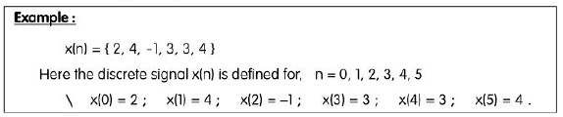
Discrete Signal and Discrete Time Signal

Slide 9
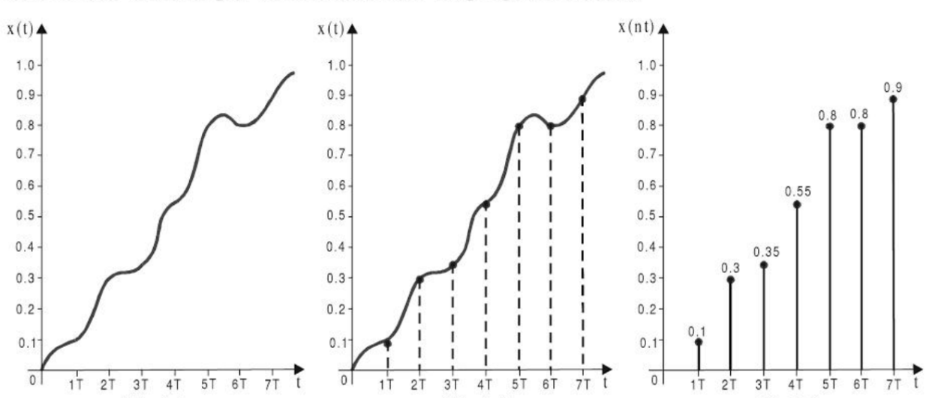
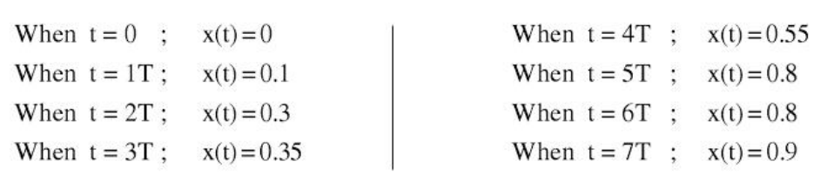
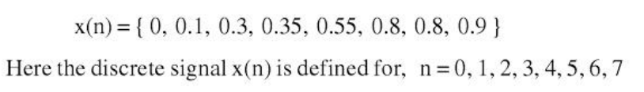
Digital Signal

Slide 10
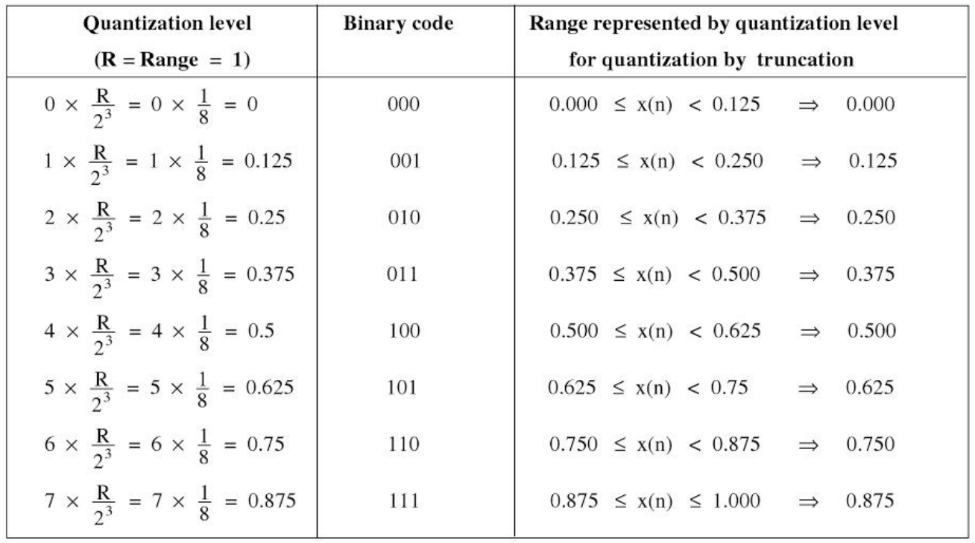
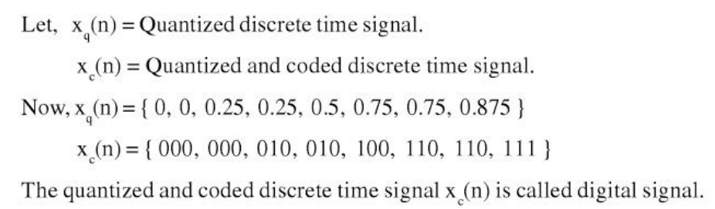
Digital Signal

Slide 11
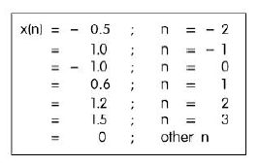
Representation of Discrete Time Signals
Functional Representation

Slide 12
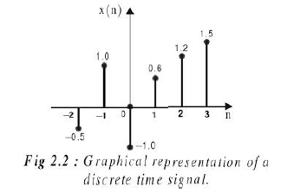
Representation of Discrete Time Signals
Graphical Representation

Slide 13

Representation of Discrete Time Signals
Tabular Representation

Slide 14
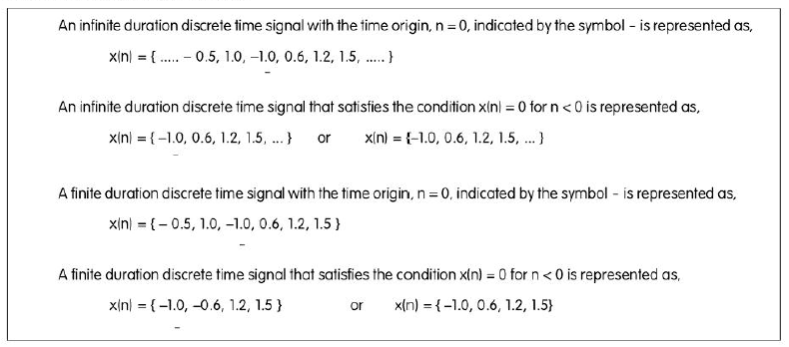
Representation of Discrete Time Signals
Sequence Representation

Slide 15
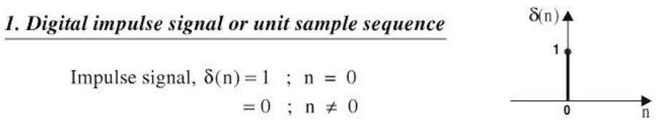
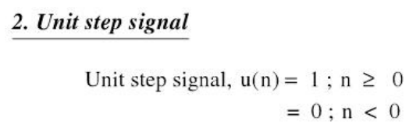
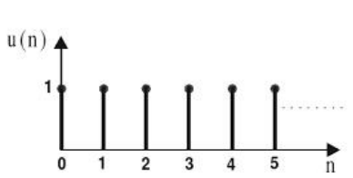
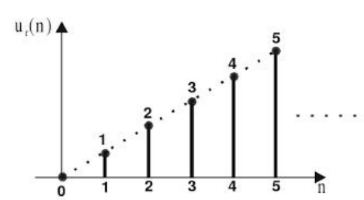
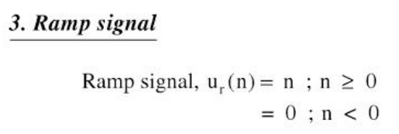
Standard Discrete Time Signal

Slide 16
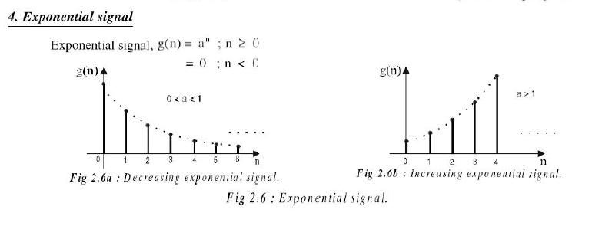
Standard Discrete Time Signal

Slide 17
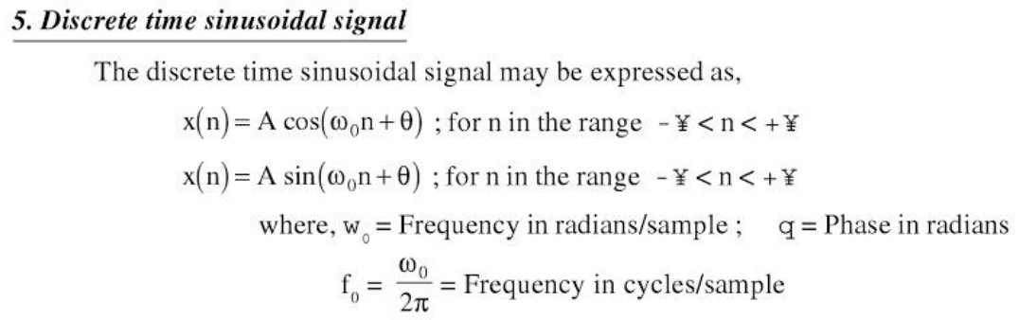
Standard Discrete Time Signal

Slide 18
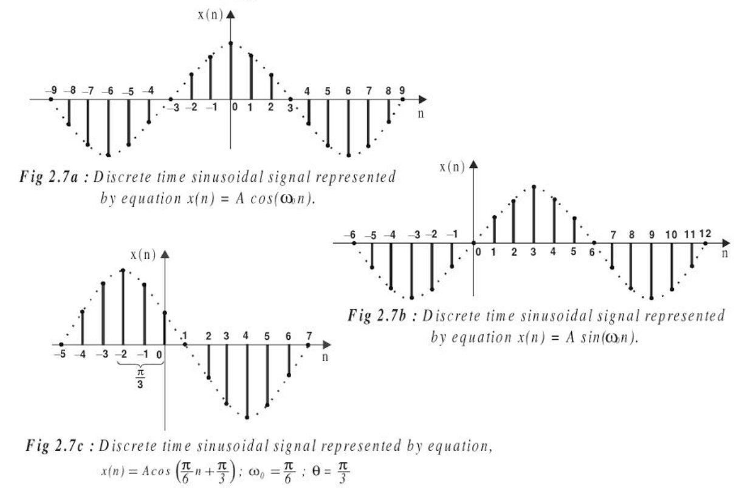

Slide 19
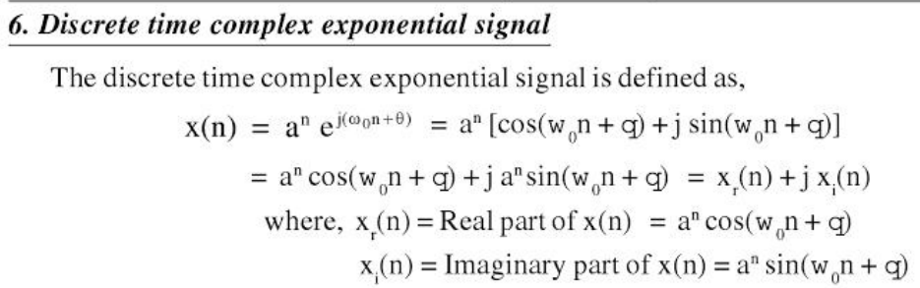
Standard Discrete Time Signal

Slide 20
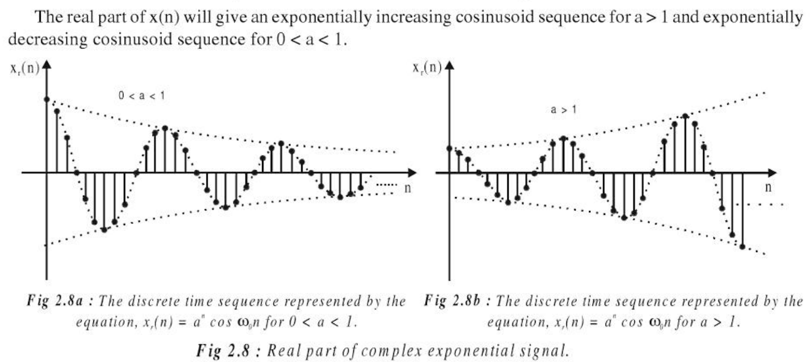

Slide 21
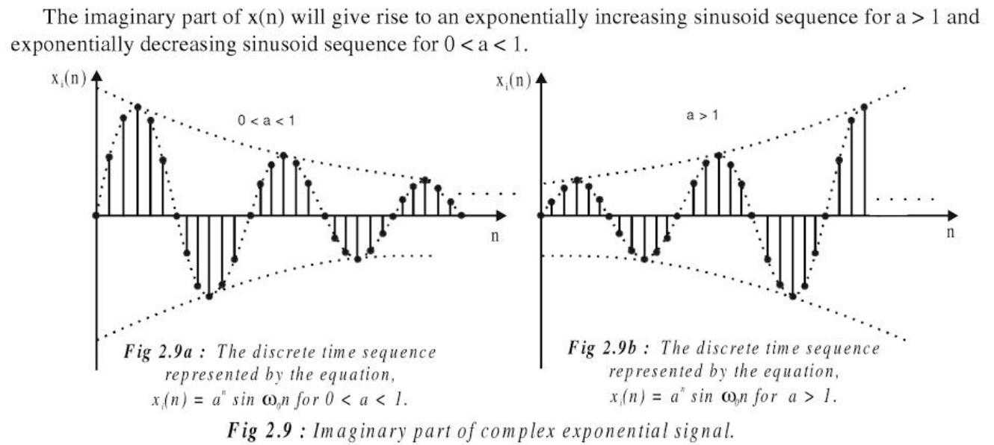

Slide 22

Sampling theorem
A continuous time signal can be represented in its samples and can be recovered back when sampling frequency f_{s} is greater than or equal to the twice the highest frequency component of message signal (fm).

Slide 23
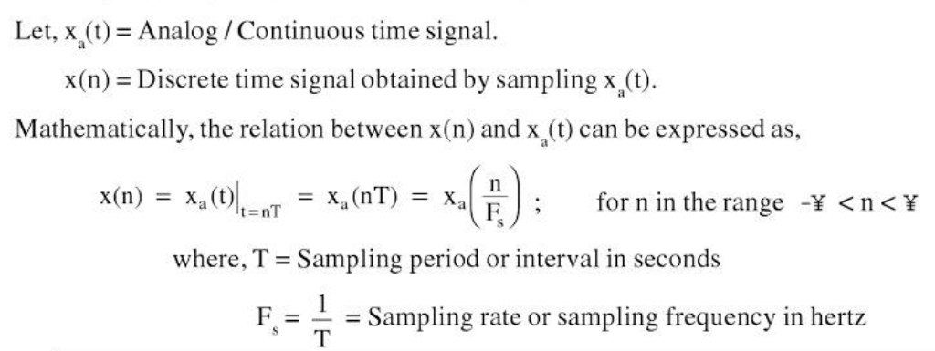
Relationship between analog and digital signal by sampling

Slide 24
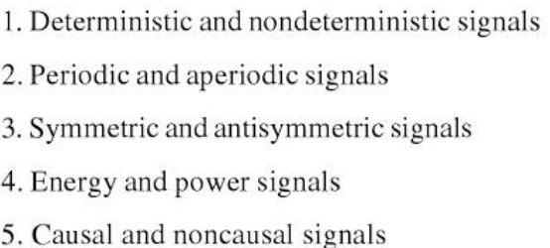
Classification of Discrete Time Signals

Slide 25
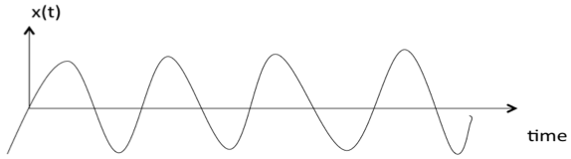
Deterministic and Non-deterministic Signals
A signal is said to be deterministic if there is no uncertainty with respect to its value at any instant of time. Or, signals which can be defined exactly by a mathematical formula (Eg: Ramp , Unit Step, exponential, sinusoidal) are known as deterministic signals.

Slide 26
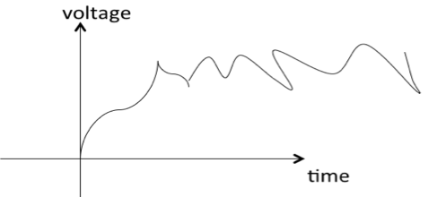
Deterministic and Non-deterministic Signals
A signal is said to be non-deterministic if there is uncertainty with respect to its value at some instant of time. Non-deterministic signals are random in nature hence they are called random signals. Random signals cannot be described by a mathematical equation. They are modelled in probabilistic terms.

Slide 27
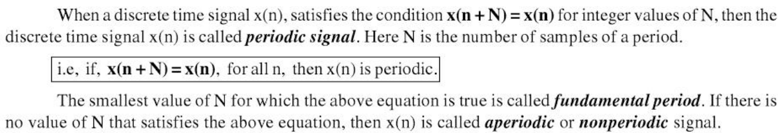
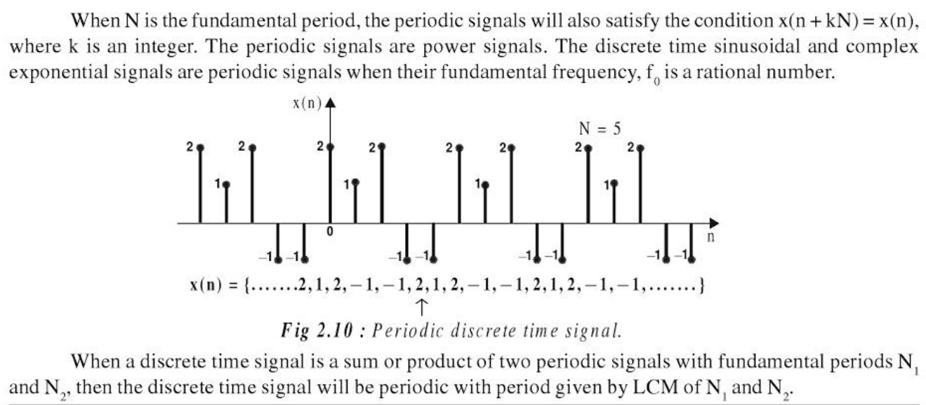
Periodic and Aperiodic Signals

Slide 28



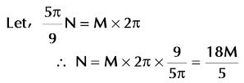
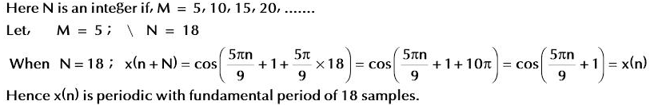

Slide 29

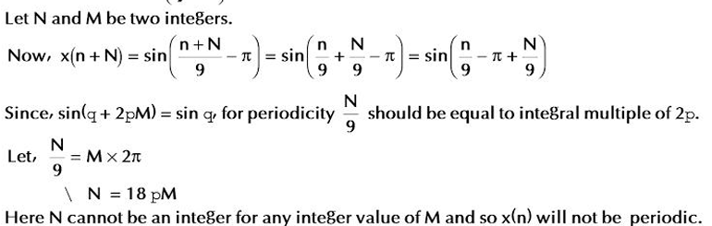

Slide 30
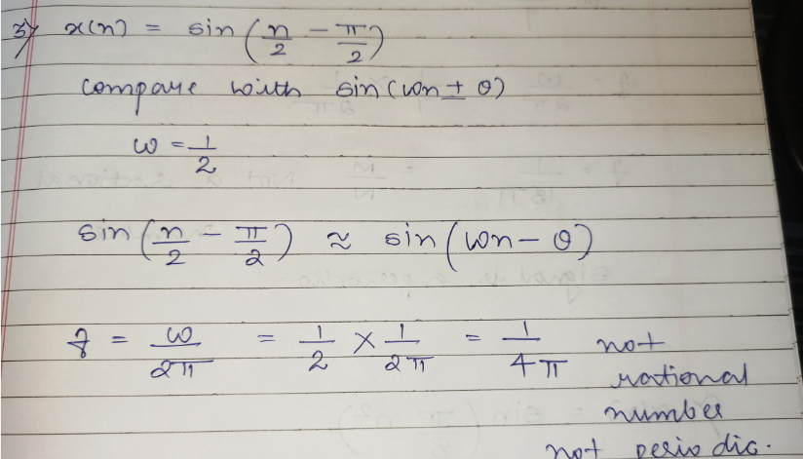

Slide 31
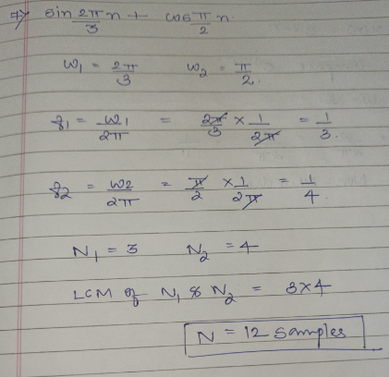

Slide 32
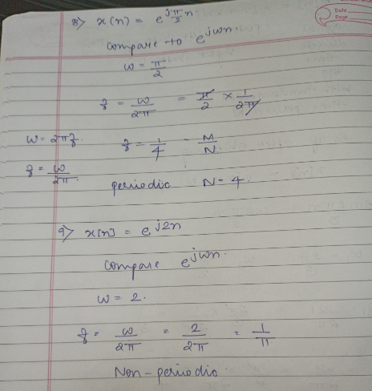

Slide 33
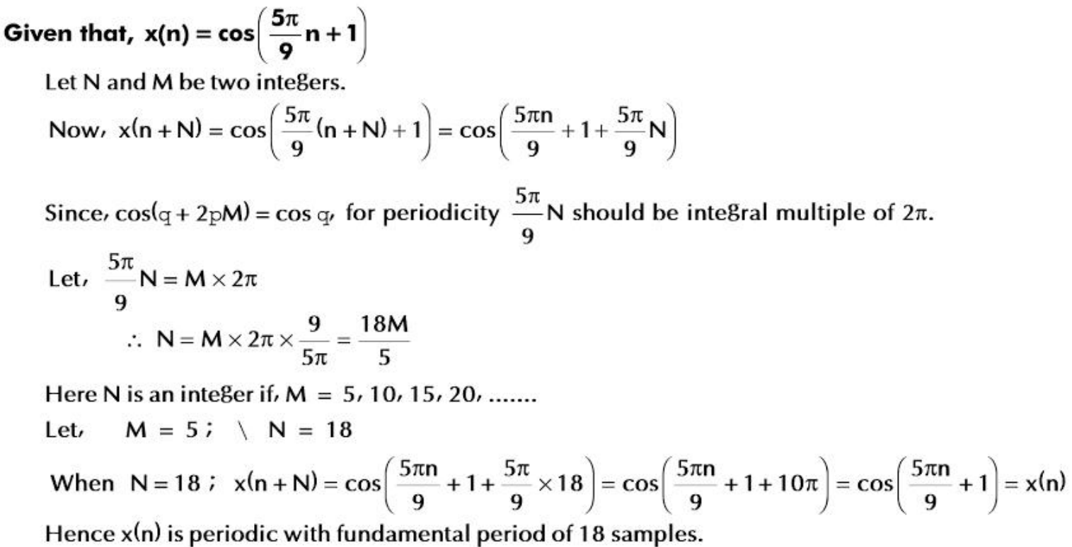

Slide 34
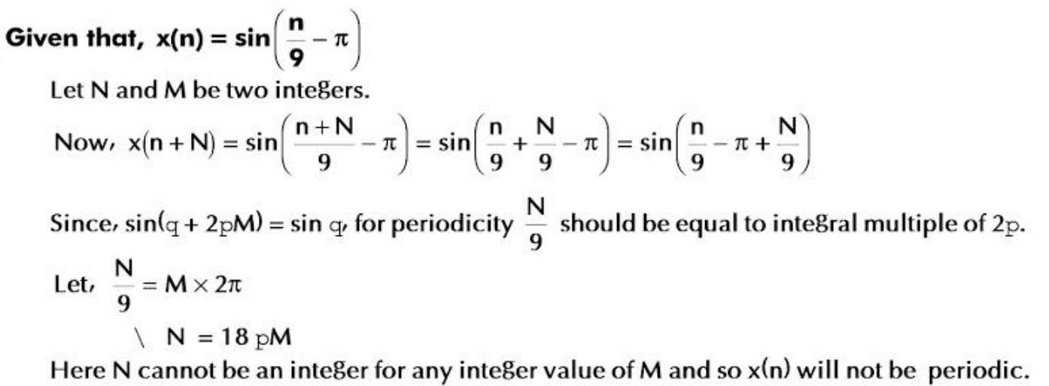

Slide 35
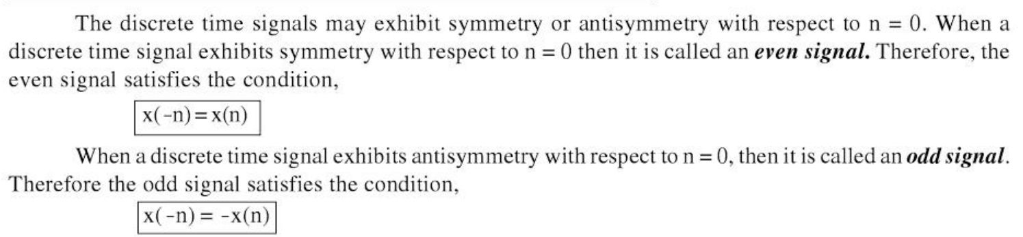
Symmetric(EVEN) and antisymmetric(ODD) signals

Slide 36


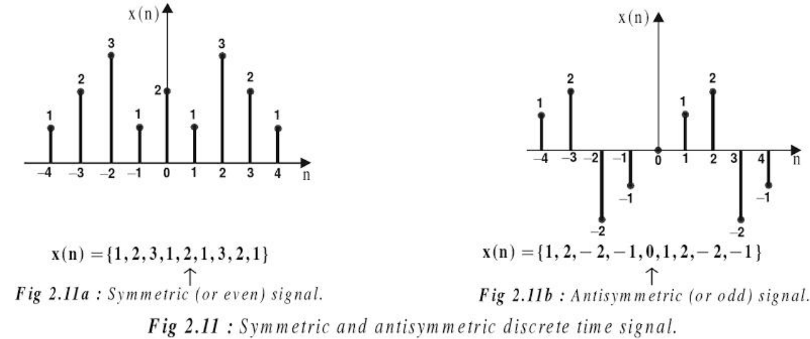
Symmetric(EVEN) and antisymmetric(ODD) signals

Slide 37
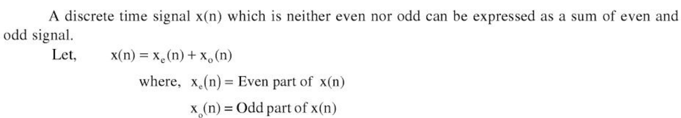
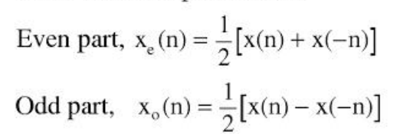
Symmetric(EVEN) and antisymmetric(ODD) signals

Slide 38
Symmetric(EVEN) and antisymmetric(ODD) signals

Slide 39

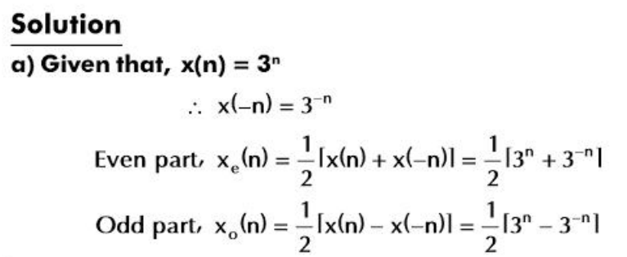
Symmetric(EVEN) and antisymmetric(ODD) signals

Slide 40

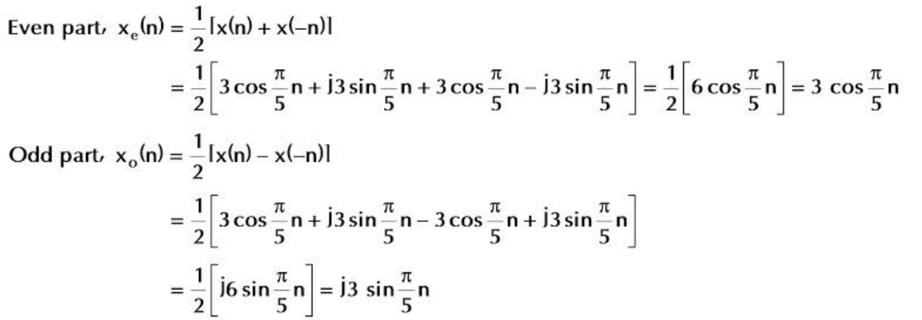
Symmetric(EVEN) and antisymmetric(ODD) signals

Slide 41
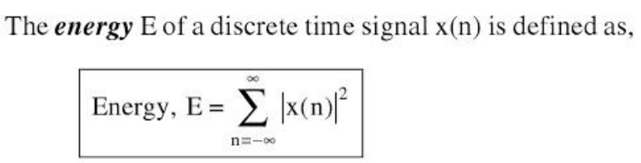
Energy and Power Signals

Slide 42
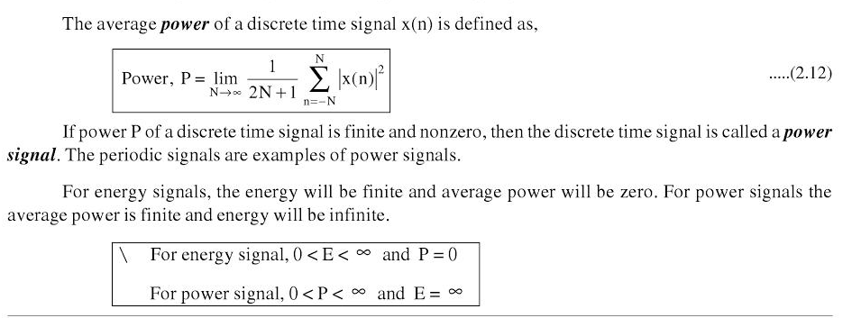
Energy and power signals

Slide 43
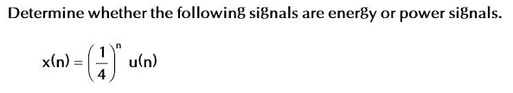
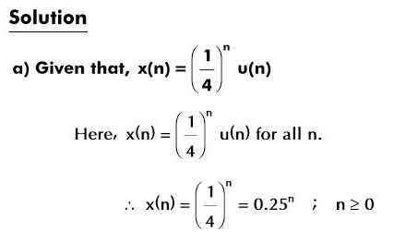

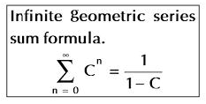
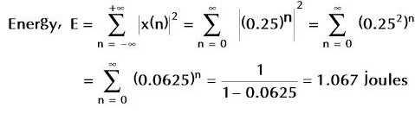

Slide 44

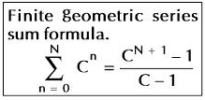
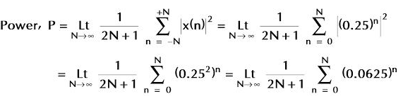


Slide 45




Slide 46
Causal, Noncausal, Anticausal Signals
Causal Signal
Non Causal if defined for n<=0 or for both n>0 and n<=0
If system is non causal then:
A non-causal signal can be converted into causal by multiplying it by unit step signal.
When a non causal signal is defined for only n<0 then it is called anticausal signal.

Slide 47


Slide 48

Mathematical operations on Discrete Time Signals

Slide 49

1. Scaling

Slide 50

1. Scaling

Slide 51


Slide 52

2. Folding

Slide 53
3.Time Shifting of Discrete Time Signals
X(n) signal will be shifted by variable m i.e. x(n)=x(n-m)
m is positive integer signal is delayed by m units of time.
Delay results in shifting each sample of x(n) to right.
m is negative integer signal is advanced by m units of time.
Advance results in shifting each sample of x(n) to left.

Slide 54


Slide 55

4. Addition of Discrete Time Signal

Slide 56


Slide 57

5.Multiplication of Discrete time signals

Slide 58


Slide 59
Discrete Time System
Discrete time system is device or algorithm which accepts input in discrete signal form to produce output or response in discrete time signal form.

Slide 60

Discrete Time System

Slide 61
LTI (Linear Time Invariant) System
A discrete time system is linear if it obeys principle of superposition and time invariant if input output relationship does not change with time.
When system satisfies property of linearity and time invariance it is called as LTI system.

Slide 62
Block Diagram and Signal Flow graph Representation of DT System
Basic elements of Representation are:
Adder
Constant Multiplier – Constant scaling factor
Unit Delay Element – one sample unit to delay
Unit Advance Element - one sample unit to advance

Slide 63


Slide 64
Block Diagram and Signal Flow graph Representation of DT System

Slide 65


Slide 66



Slide 67

Static system and Dynamic System
Static System – Output depends on only current input samples but not on past or future samples – no memory
Dynamic System – Opposite of static

Slide 68


Slide 69


Slide 70
Time Invariant and Time Variant System
A system is said to be time invariant if its input output characteristics do not change with time.

Slide 71


Slide 72



Test the following system for time variance

Slide 73


Test the following system for time variance

Slide 74



Test the following system for time variance

Slide 75


Test the following system for time variance

Slide 76

Linear and Non Linear System

Slide 77

Linear and Non Linear System(Check for Linearity)

Slide 78

Test the following system for linearity.

Slide 79


Slide 80


Slide 81


Slide 82


Slide 83


Slide 84



Slide 85

Causal and Non Causal Systems

Slide 86

Causal and Non Causal Systems

Slide 87


Causal and Non Causal Systems

Slide 88
Causal and Non Causal Systems

Slide 89

Stable and Unstable

Slide 90


Stable and Unstable

Slide 91



Slide 92
FIR and IIR Systems
FIR system (Finite duration Impulse Response System) , the impulse response consists of finite number of samples.
IIR system (Infinite duration Impulse Response System) , the impulse response consists of infinite number of samples.

Slide 93



Slide 94

Discrete or Linear Convolution

Slide 95
Discrete or Linear Convolution
In linear convolution the x1 and x2 sequences are non periodic , hence convolution result x3 is also non periodic.
Linear convolution is said to be aperiodic.

Slide 96

Procedure

Slide 97

Properties

Slide 98


Slide 99




Slide 100



Slide 101

Graphical Method

Slide 102


Slide 103


Slide 104


Slide 105


Slide 106


Slide 107


Slide 108


Slide 109


Slide 110


Slide 111



Slide 112


Slide 113


Slide 114


Circular Convolution

Slide 115
Circular Convolution-Procedure

Slide 116


Slide 117


Slide 118


Slide 119


Slide 120


Slide 121


Slide 122


Slide 123



Slide 124


Slide 125



Slide 126


Slide 127


Slide 128



Slide 129


Slide 130


Slide 131


Slide 132



Slide 133


Slide 134
Correlation
Used when two signals are to be compared.
Measure of degree to which two signals are similar.
Cross Correlation – correlation of two separate signals
Auto Correlation – correlation of signal with itself.

Slide 135



Cross Correlation

Slide 136
Cross Correlation
Number of Samples = N1+N2-1
Start of Sequence mi = n1-(n2+N2-1)
End of Sequence mf = mi+(N1+N2-2)

Slide 137

Auto Correlation

Slide 138
Auto Correlation
Number of Samples = 2N-1
Start of Sequence
initial value of m:mi = -(N-1)
End of Sequence
final value of m: mf = mi+(2N-2)

Slide 139



Slide 140



Slide 141



Slide 142



Slide 143



Slide 144




Slide 145


Slide 146


Slide 147


Slide 148


Slide 149
Thank you

